Slide 1
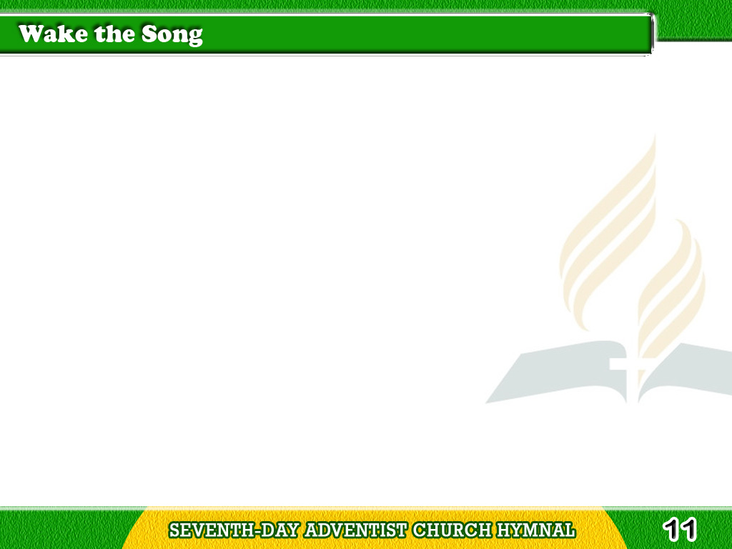
1/3
Wake the song of joy
and gladness;
Hither bring your
noblest lays;
Tagalog
Version

Slide 2
1/3
Banish every thought
of sadness,
Pouring forth your
highest praise.
Tagalog
Version

Slide 3
1/3
Sing to Him whose care
has brought us
Once again with friends
to meet,
Tagalog
Version

Slide 4
1/3
And whose loving voice
has taught us
Of the way to Jesus feet.
Tagalog
Version

Slide 5
1/3
Chorus
Wake the song, wake the song,
the song of joy and gladness,
Wake the song, wake the song,
The song of jubilee.
Tagalog
Version

Slide 6
2/3
Joyfully with songs
and banners,
We will greet
the festal day;
Tagalog
Version

Slide 7
2/3
Shout a loud our glad
hosannas,
And our grateful
homage pay.
Tagalog
Version

Slide 8
2/3
We will chant our
Savior’s glory
While our thoughts
we raise above,
Tagalog
Version

Slide 9
2/3
Telling still the old,
old story,”
Precious theme
redeeming love!
Tagalog
Version

Slide 10
2/3
Chorus
Wake the song, wake the song,
the song of joy and gladness,
Wake the song, wake the song,
The song of jubilee.
Tagalog
Version

Slide 11
3/3
Thanks to Thee,
O holy Father,
For the mercies
of the year;
Tagalog
Version

Slide 12
3/3
May each heart,
as here we gather,
Swell with gratitude
sincere.
Tagalog
Version

Slide 13
3/3
Thanks to Thee,
O loving Savior,
For redemption
through Thy blood.
Tagalog
Version

Slide 14
3/3
Breathe upon us,
Holy Spirit,
Sweetly draw us
near to God.
Tagalog
Version

Slide 15
3/3
Chorus
Wake the song, wake the song,
the song of joy and gladness,
Wake the song, wake the song,
The song of jubilee.
Tagalog
Version

